Slide 1
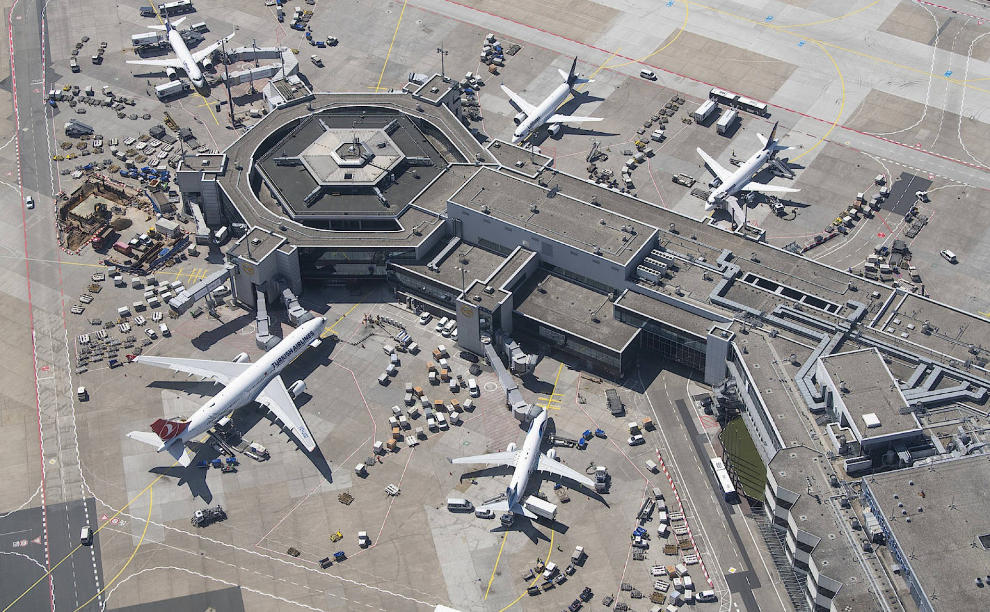
Milestone 2:Design
Kaan Baylan, Stefan Haslhofer, Simon Primetzhofer, Jonas Reichhardt

Slide 2
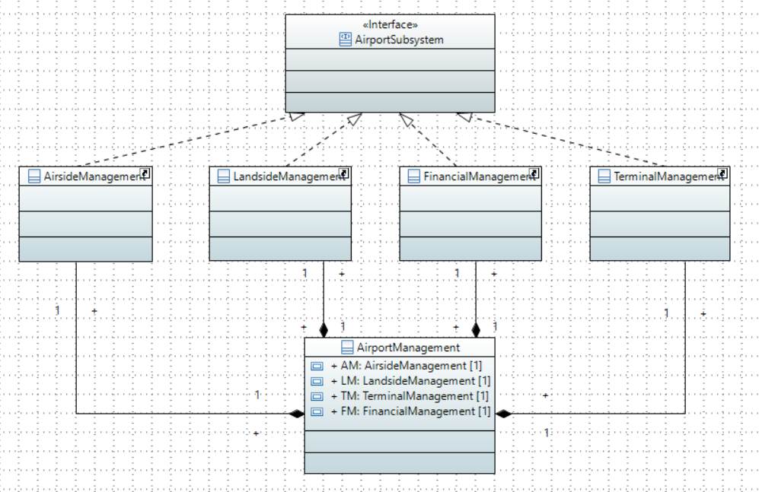
Overall Class Diagramm

Slide 3

Airside Management
Overall Class Diagramm

Slide 4
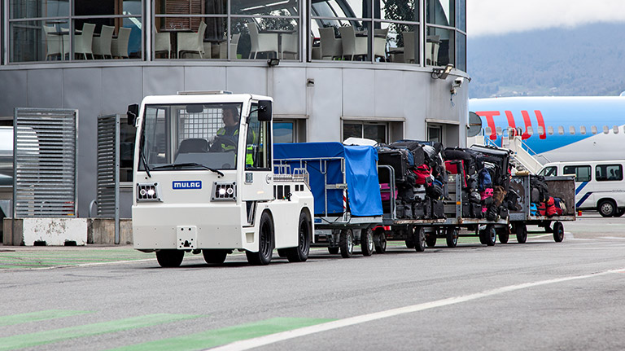
Landside management

Slide 5

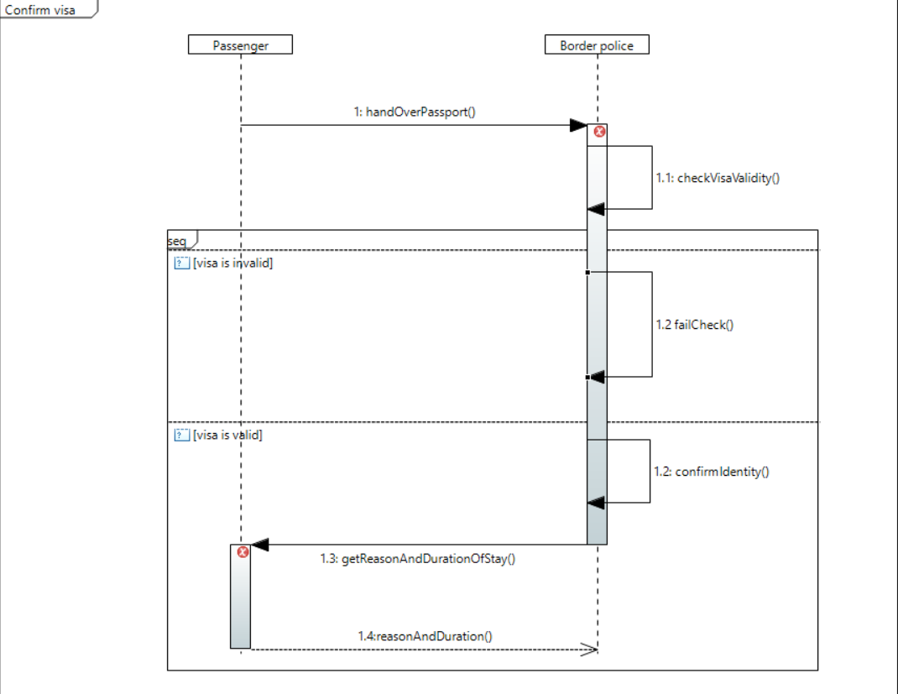
Terminal Management

Slide 6
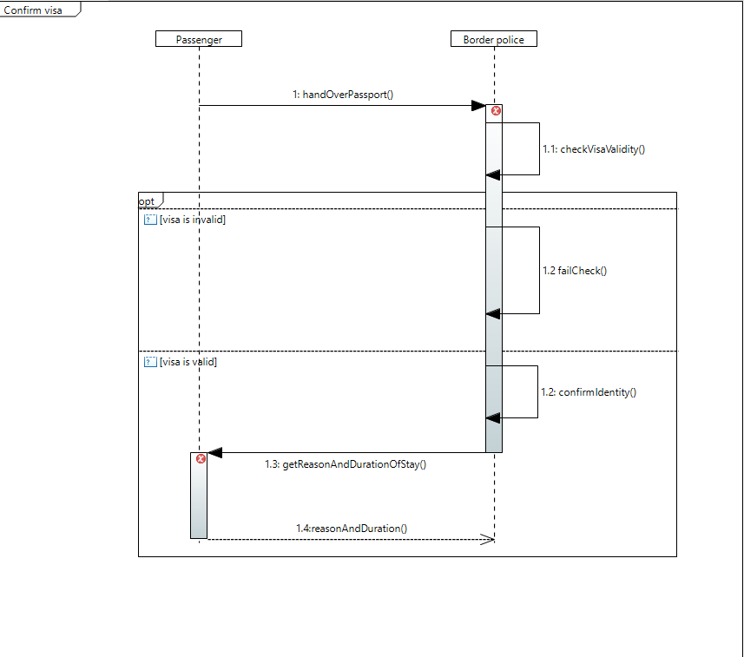
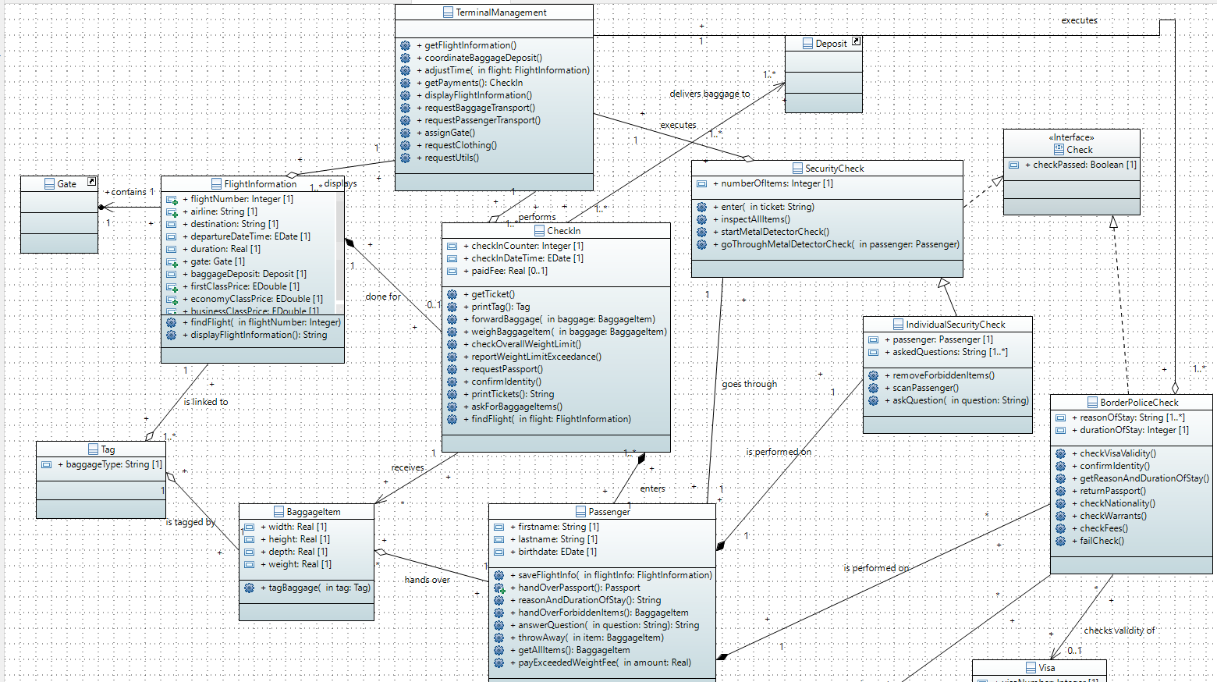
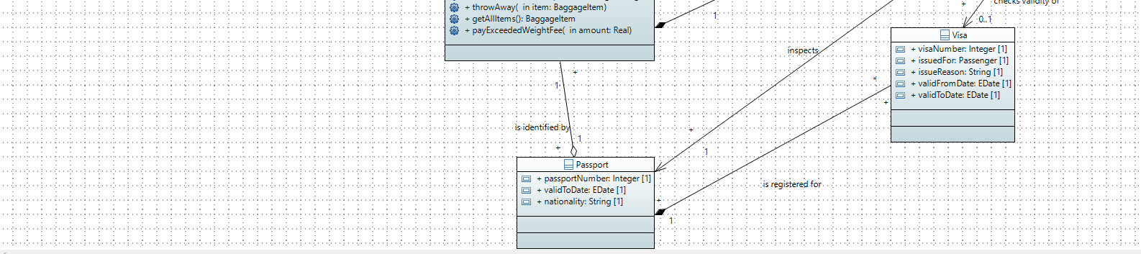

Slide 9

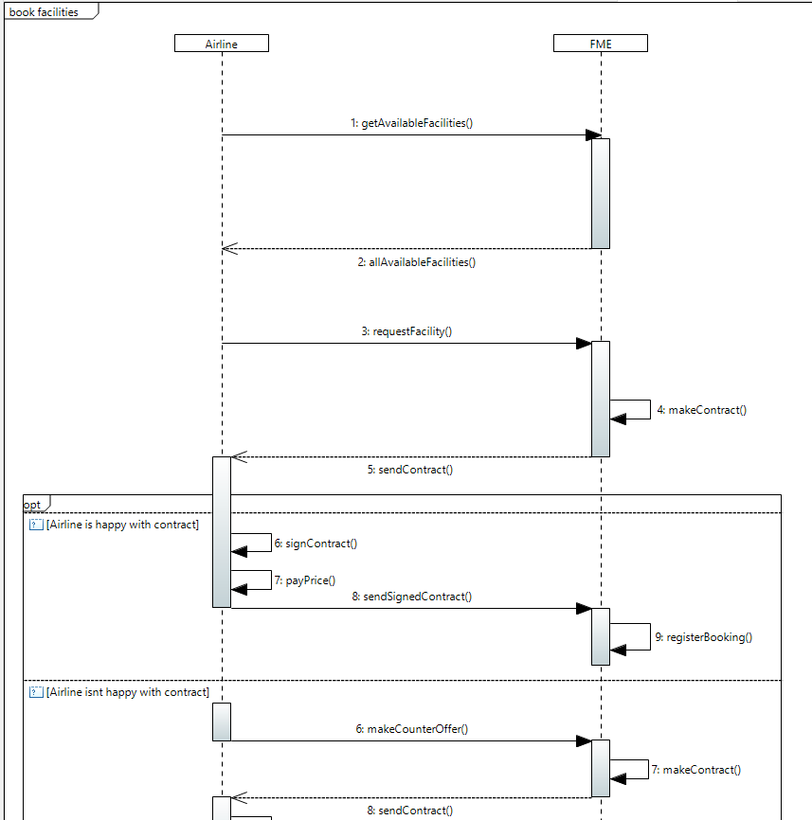
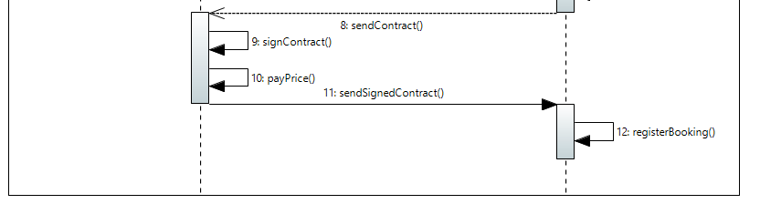
Financial management

Slide 11
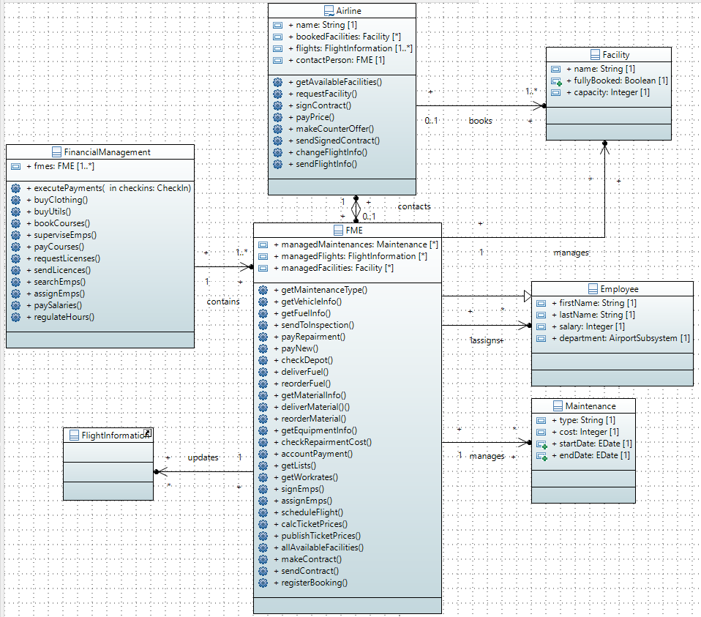

Slide 14
Thanks for your attention

